Slide 1
Selected topics 1
Python
Dr: Nashwa Nageh

Slide 2
Agenda
Introduction
What is python
characteristics of Python
Installation
Variables
User-input
Print in Python

Slide 3








What is python
Python is a high-level, interpreted programming language known for its simplicity and readability.
Python was created by Guido van Rossum and first released in 1991.
Python is designed to be easy to understand and write.
Python is a popular choice for both beginners and experienced programmers.

Slide 4





What is python
Python is commonly used for a wide range of applications, including web development, data analysis, scientific computing, machine learning, artificial intelligence, automation, scripting, and more.
Its versatility and ease of use make it a popular choice for a variety of programming tasks.

Slide 5

characteristics of Python
Readability: Python uses a clean and concise syntax, which emphasizes code readability. This makes it easy to write and maintain Python programs.
Interpreted: Python is an interpreted language, which means that you don't need to compile your code before running it. The Python interpreter reads and executes the code line by line, making it suitable for quick prototyping and development.
High-level: Python abstracts many low-level details, making it easier to focus on solving problems rather than managing memory or hardware-specific operations.
Multi-paradigm: Python supports multiple programming paradigms, including procedural, object-oriented, and functional programming. This flexibility allows developers to choose the style that best fits their needs.

Slide 6
characteristics of Python
Cross-platform: Python is available on various platforms, including Windows, macOS, and various Unix-based operating systems. This makes it a versatile choice for developing applications that can run on different platforms.
Large standard library: Python comes with a comprehensive standard library that includes modules and packages for a wide range of tasks, from file handling to web development. This extensive library reduces the need for reinventing the wheel and accelerates development.
Active community: Python has a large and active community of developers, which means there are abundant resources, libraries, and frameworks available for various purposes. The Python Package Index (PyPI) hosts a vast collection of third-party packages that extend Python's capabilities.
Open-source: Python is open-source software, which means it is free to use, modify, and distribute. This has contributed to its widespread adoption and popularity.

Slide 7
Installation
To get started with Python, you'll need to install it on your computer. You can download the Python interpreter from the official website (https://www.python.org/downloads/) and follow the installation instructions for your specific platform.
Once Python is installed, you can start writing and executing Python code using various development environments, such as IDLE (Python's built-in IDE), Jupyter Notebook, or code editors like Visual Studio Code and PyCharm

Slide 8

Variables
In Python, variables are used to store and manipulate data. Python is a dynamically typed language, which means that you don't need to declare the data type of a variable explicitly. Instead, Python infers the data type based on the value assigned to the variable.
Python is also dynamically typed, which means that a variable can change its type during the execution of a program if you assign a new value to it with a different type. For example, you can start with an integer and later assign a string to the same variable. However, this dynamic typing should be used carefully to avoid unexpected behavior in your code.

Slide 9
Variable types
Here are some common variable types in Python
Variable name | example
integer (int): | Represents whole numbers, both positive and negative age = 25
Float (float): | Represents floating-point numbers (numbers with decimal points) price = 19.99
String (str): | Represents a sequence of characters, enclosed in single or double quotes name = "Alice"
Boolean (bool): | Represents a binary value, which can be either True or False is_student = True
List (list): | Represents an ordered collection of items that can be of different types. Lists are mutable, which means you can change their contents fruits = ["apple", "banana", "cherry"]

Slide 10
Variable types
Variable name | example
Tuple (tuple): | Similar to lists, but they are immutable, meaning you cannot change their contents once defined. Tuples are often used for grouping related values together coordinates = (3, 4)
Dictionary (dict): | Represents a collection of key-value pairs. Keys must be unique, and they are used to access the associated values person = {"name": "John", "age": 30}
Set (set): | Represents an unordered collection of unique elements. Sets are used when you need to store a collection of items without duplicates unique_numbers = {1, 2, 3, 4, 5}
NoneType (None): | Represents a special value denoting the absence of a value or a null value. It is often used to initialize variables or indicate that a function has no return value result = None

Slide 11
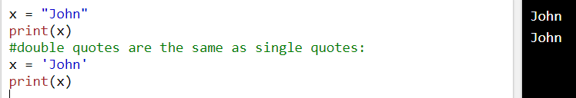
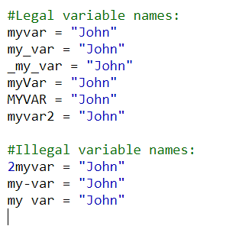
Creating Variables
A variable name must start with a letter or the underscore character
A variable name cannot start with a number
A variable name can only contain alpha-numeric characters and underscores (A-z, 0-9, and _ )
Variable names are case-sensitive (age, Age and AGE are three different variables)

Slide 12
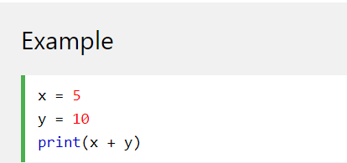
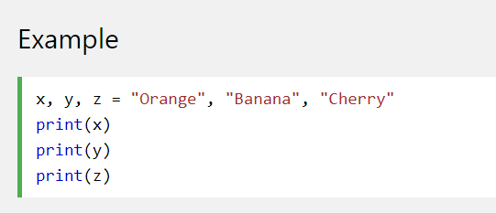
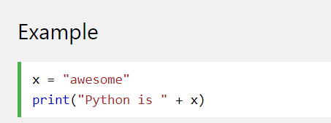
Output Variables

Slide 13
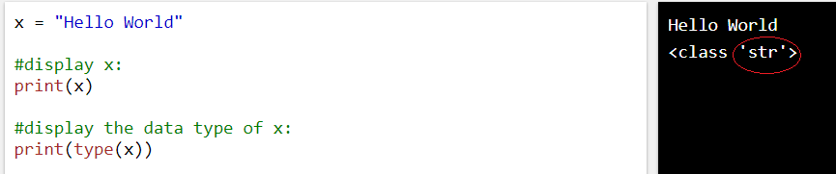
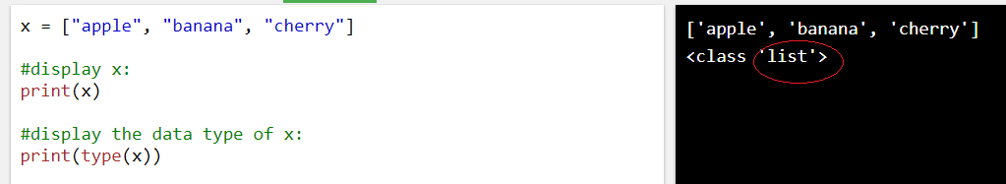
Type function

Slide 14
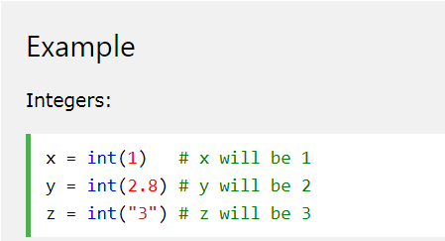
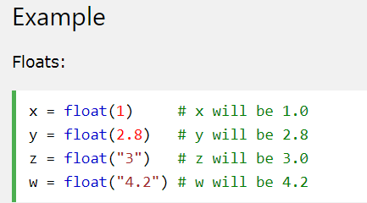
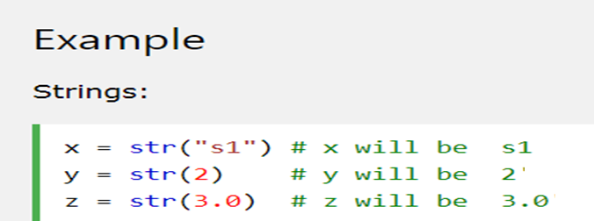
Python Casting
Python Casting

Slide 15
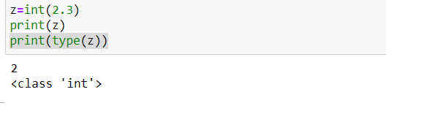
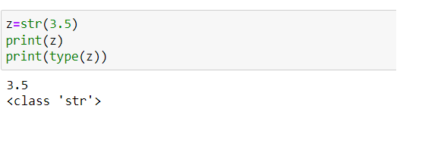
Python Casting

Slide 16
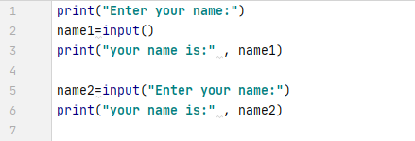
User-input

Slide 17
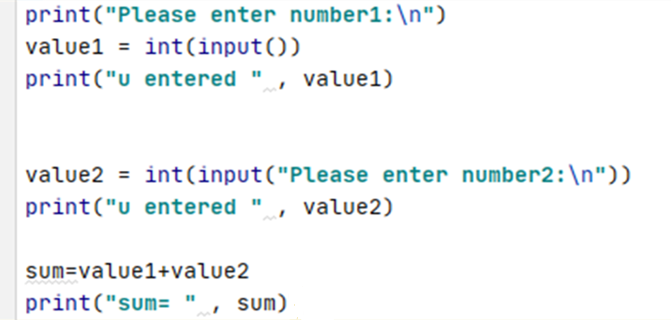
User-input

Slide 18
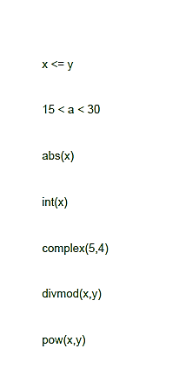
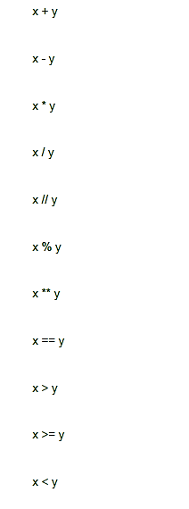











Operations
Integers values
Convert x into integer
power
(5+4j)
True of false

Slide 19
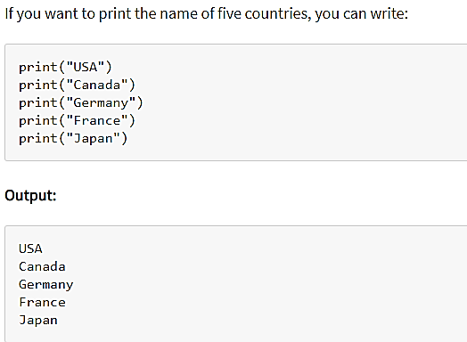
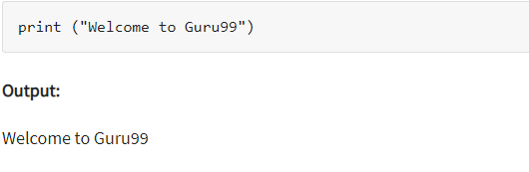
Print in Python

Slide 20
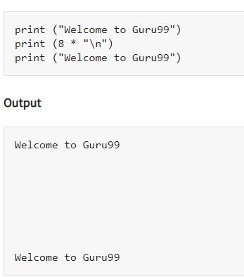
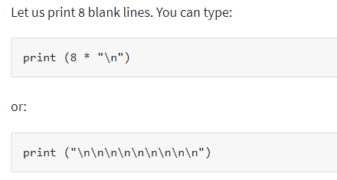
Print in Python

Slide 21
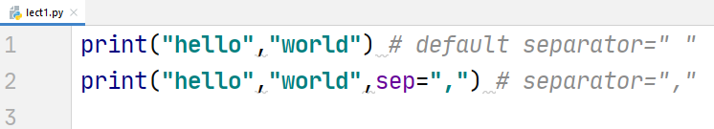


Print in Python (Separator)

Slide 22
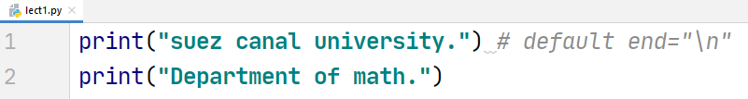
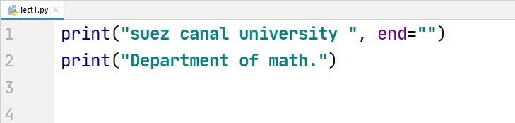
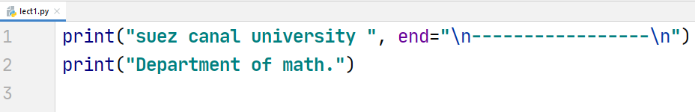

Print in Python (end)

Slide 23
Thank you
Nashwa Nageh
nashwa.nageh88@gmail.com

